Slide 1
VTK: The Visualization Toolkit
An Object Oriented Approach to 3D Graphics
Robert J. Stein
Visualization Programmer
National Center for Supercomputing Applications
rstein@ncsa.uiuc.edu
Notes:
This are my notes for this slide

Slide 2
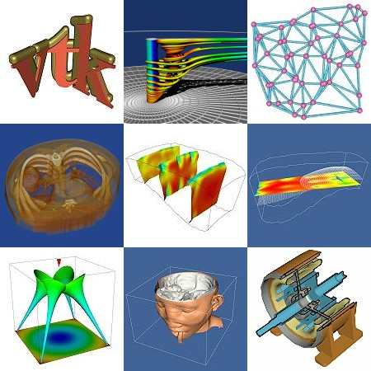
What is VTK?
The Visualization Toolkit (vtk) is an
open source, freely available software
system for 3D computer graphics,
image processing, and visualization.
Support for hundreds of algorithms in
visualization and image processing
fields
Object Oriented design allows Easy to
Use programming interface for access
to core components
Several different interpreted language
bindings to allow for fast development

Slide 3
Technical Overview
The core objects and algorithms in VTK are written entirely in C++
There are over 500 existing classes with 200,000+ lines of code. This is a large package!
VTK will compile and run on a variety of systems supporting a variety of graphics architectures
  Windows 98/NT, SGI, Sun, HP, Linux, other…
  Supports OpenGL, Mesa, Starbase, and xgl
VTK has a number of different interfaces from other languages including:
  Tcl/Tk, Java, and Python
VTK includes support for a wide variety of file formats
  Inventor, 3DS, PLOT3D, PNM, RIB, SLC, VRML, OBJ, Raw

Slide 4
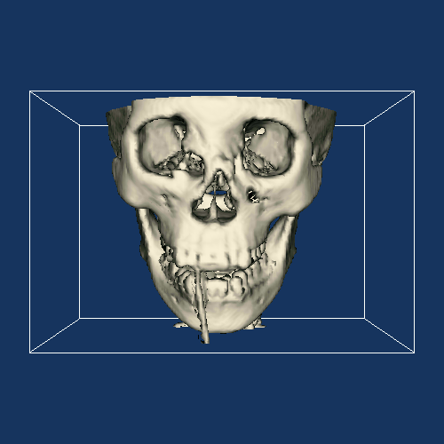
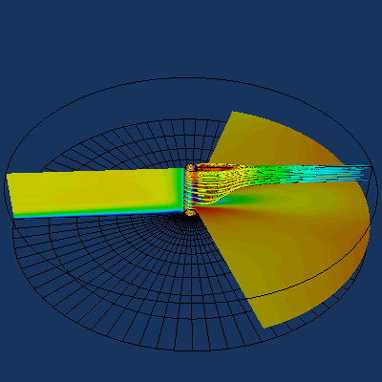
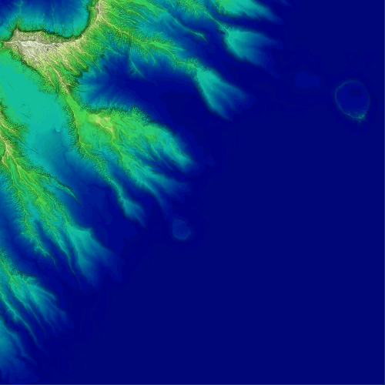
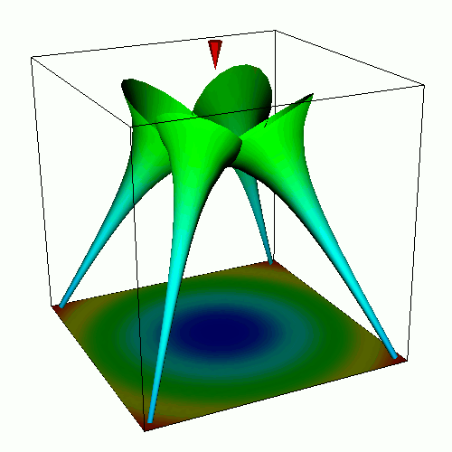
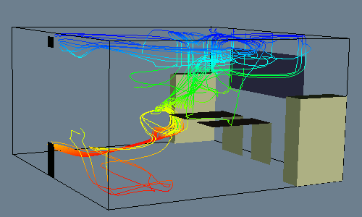
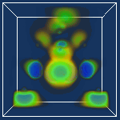
What can you do with VTK?
Medical Visualization
C.F.D
G.I.S
Flow Visualization
Tensor Visualization
Volume Rendering

Slide 5
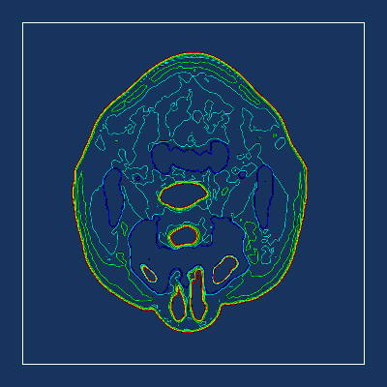
Algorithms
CT Scan of a Human Head
vtkContourFilter & vtkCutter

Slide 6
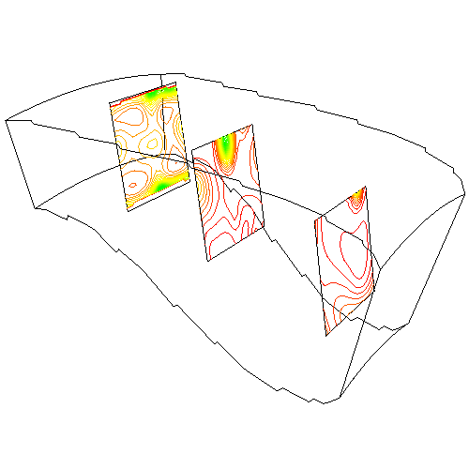
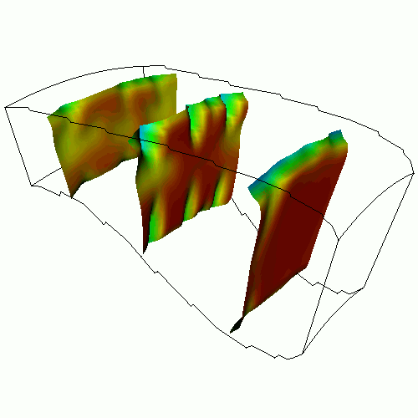
Algorithms
Flow density and energy in a Combustion Chamber
vtkProbeFilter & vtkContourFilter
vtkCutter & vtkWarpVectors

Slide 7
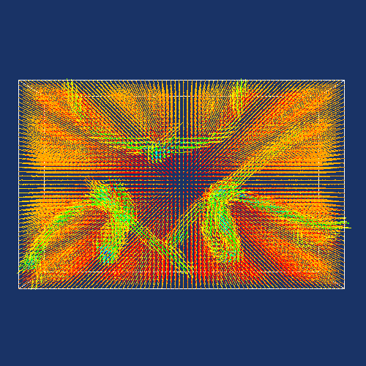
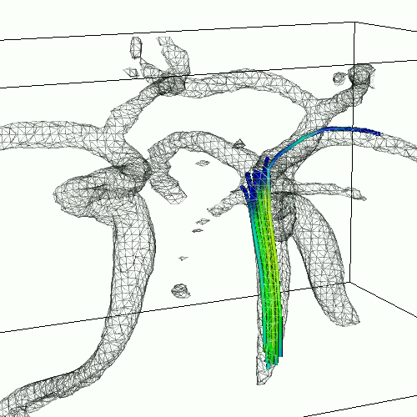
Algorithms
Blood flow in the Human Carotid Arteries
vtkHedgeHog
vtkContourFilter, vtkStreamLines &
vtkTubeFilter

Slide 8
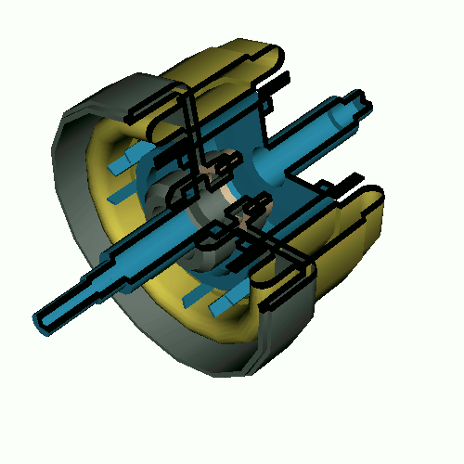
Algorithms
Verticle Post in Fluid Flow
CAD Model of a Motor
vtkStreamLines, vtkTubeFilter,
vtkDataSetMapper, & vtkCutter
vtkPolyDataMapper, &
vtkTextureThreshold

Slide 9
Supported Data Types
Structured Points
Rectilinear Grid
Unstructured Points
Structured Grid
Polygonal Data
Unstructured Grid

Slide 10
The Visualization Pipeline
VTK uses the functional model of a Visualization Pipeline for transforming data into images or geometry
Source Objects
Filter Objects
Mapper Objects
A Pipeline Consists Of:
Source Objects: interface to external data, or generate data based on
local parameters (e.g. vtkPLOT3DReader)
Filter Objects: operate on data from Source objects and generate
geometry and/or images (e.g. vtkContourFilter)
Mapper Objects: take the resulting data from a Filter Object and
process it for display or writing to a file (e.g. vtkPolyDataMapper)

Slide 11
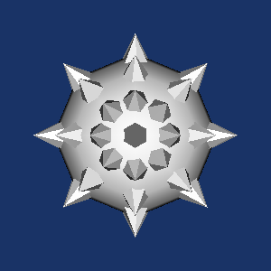
Example Pipeline
vtkSphereSource
vtkConeSource
Mace.tcl
vtkGlyph3D
vtkPolyDataMapper
vtkPolyDataMapper

Slide 12
A Short Example
Create an isosurface of the wave function of a high potential iron protien dataset
C++
Tcl
//Create the RenderWindow and Renderer
vtkRenderer *ren = vtkRenderer::New();
vtkRenderWindow *renWin = vtkRenderWindow::New();
renWin->AddRenderer(ren);
//Read in the Data
vtkStructuredPointsReader *reader =
vtkStructuredPointsReader::New();
reader->SetFileName(“ironProt.vtk”);
#Create the RenderWindow, Renderer
vtkRenderer ren
vtkRenderwindow renWin
renWin AddRenderer ren
# Read in the Data
vtkStructuredPointsReader reader
reader SetFileName “ironProt.vtk”

Slide 13
A Short Example (cont.)
C++
Tcl
//Setup the pipeline
vtkContourFilter *iso =
vtkContourFilter::New();
iso->SetInput(reader->GetOutput());
iso->SetValue(0, 128.0f);
vtkPolyDataMapper *isoMapper =
vtkPolyDataMapper::New();
isoMapper->SetInput(iso->GetOutput());
isoMapper->ScalarVisibilityOff();
# Setup the pipeline
vtkContourFiler iso
iso SetInput [reader GetOutput]
iso SetValue 0 128
vtkPolyDataMapper *isoMapper
isoMapper SetInput [iso GetOutput]
isoMapper ScalarVisibilityOff

Slide 14
A Short Example (cont.)
C++
Tcl
//Terminate the pipeline
vtkActor *isoActor = vtkActor::New();
isoActor->SetMapper(isoMapper);
//Set the color of the Actor
vtkProperty *prop =
isoActor->GetProperty();
prop->SetColor(1, 0, 0);
//Add the Actor to the renderer
ren->AddActor(isoActor);
//Render the image
renWin->Render();
# Terminate the pipeline
vtkActor isoActor
isoActor SetMapper isoMapper
# Set the color of the Actor
set prop [isoActor GetProperty]
prop SetColor 1 0 0
# Add the Actor the the renderer
ren AddActor isoActor
# Render the image
renWin Render

Slide 15
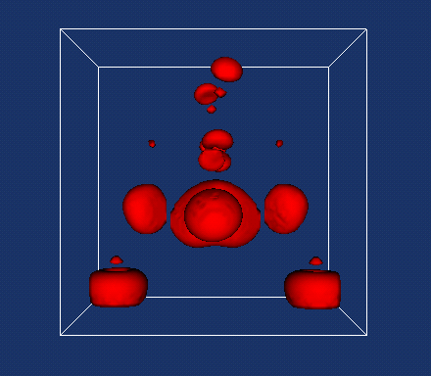
A Short Example (cont.)
Here’s the resulting Image

Slide 16
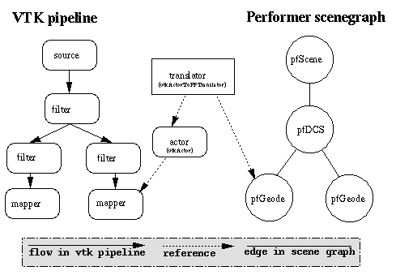
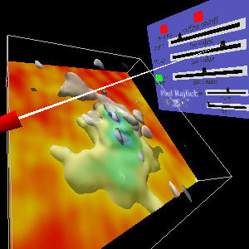
NCSA’s work with VTK
vtkActorToPerformer - http://hoback.ncsa.uiuc.edu/group/vtkActorToPF/
Allows users to display geometry generated by VTK in the CAVE via an interface to the IRIS Performer Scene Graph
contact: Paul Rajlich prajlich@ncsa.uiuc.edu

Slide 17
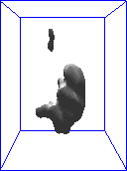
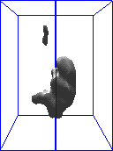
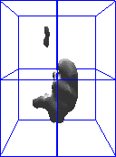
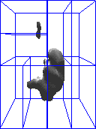
NCSA’s work with VTK
1 pipeline
2 pipelines
3 pipelines
4 pipelines
Parallel VTK - http://hoback.ncsa.uiuc.edu/group/vtkActorToPF/
Uses the vtkActorToPF framework to parallelize VTK. This
allows users to view very large datasets interactively
contact: Paul Rajlich prajlich@ncsa.uiuc.edu

Slide 18
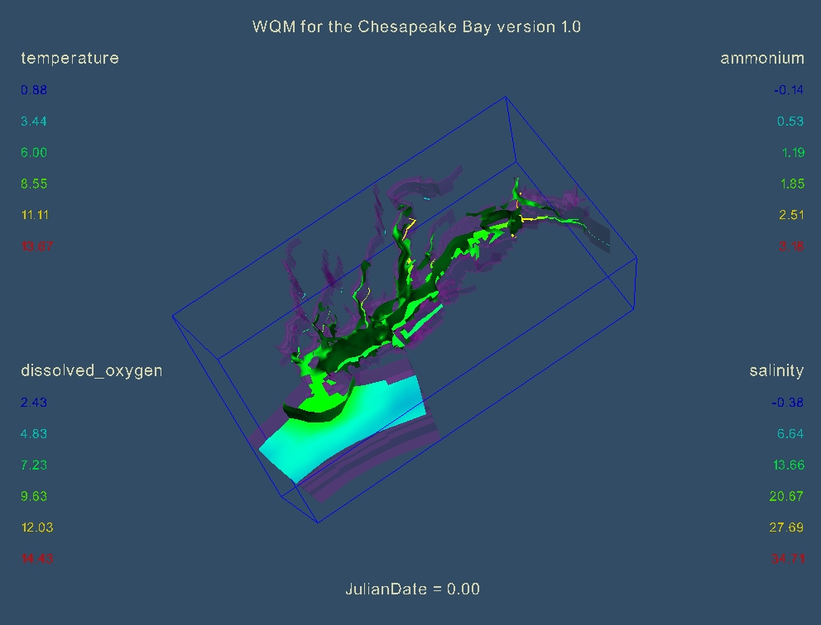
NCSA’s work with VTK
VizGen - http://wasatch.ncsa.uiuc.edu/~rstein/Projects/VizGen.html
The Visualization Generator, or VisGen, is a high level component for the development of 3D graphics applications. The VisGen is an API for easily building VTK pipelines
contact: Rob Stein rstein@ncsa.uiuc.edu

Slide 19
NCSA’s work with VTK
vtkHdfReader -
contact - John Shalf jshalf@ncsa.uiuc.edu
Using VTK with CUMULVS for Computational Monitoring
contact - Dave Semeraro semeraro@ncsa.uiuc.edu
Randy Heiland heiland@ncsa.uiuc.edu
VTK2CAVE Translator - http://www.students.uiuc.edu/~mahall/vtkpage.html
contact - Matthew Hall mahall@math.uiuc.edu

Slide 20
VTK Resources
VTK HomePage - http://www.kitware.com/vtk.html
William J. Schroeder, Kenneth M. Martin, and William E. Lorensen
The Visualization Toolkit: An Object Oriented Approach to 3D Graphics,
2nd edition. Prentice Hall PTR, 1998
William J. Schroeder, Kenneth M. Martin, and William E. Lorensen.
The design and implementation of an object-oriented toolkit for 3D
graphics and visualization. In IEEE Visualization, pages 93-100 1996

